Slide 1
M11

Slide 2

What are the specific ways?

Slide 3
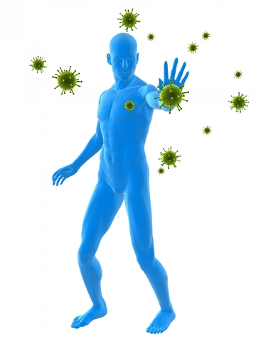
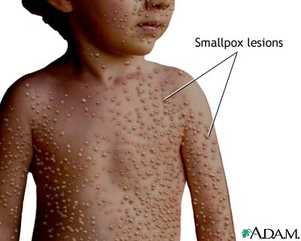
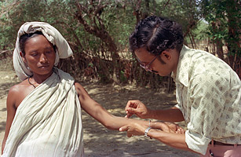
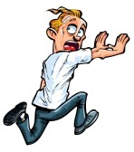
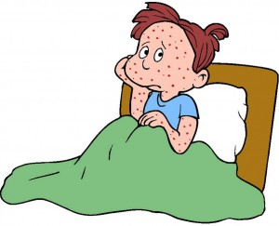
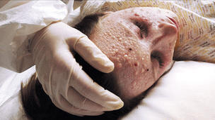
They relate to a peculiar property of the immune system that usually fights off microbial infections.
Let us cite an example to try and understand this property.
These days, there is no smallpox anywhere in the world.
But as recently as a hundred years ago, smallpox epidemics were not at all uncommon.
In such an epidemic, people used to be very afraid of coming near someone suffering from the disease since they were afraid of catching the disease.

Slide 4
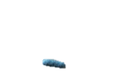
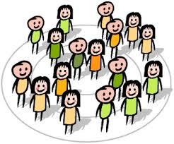

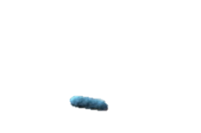

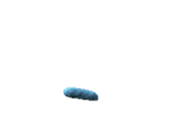
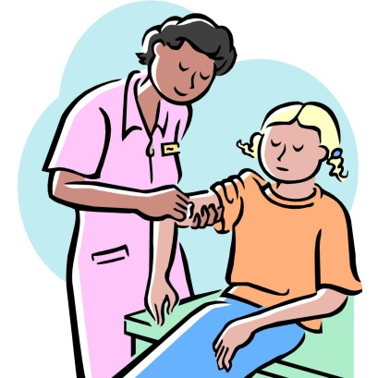
However, there was one group of people who did not have this fear.
These people would provide nursing care for the victims of smallpox.
This was a group of people who had had smallpox earlier and survived it, although with a lot of scarring.
In other words, if you had smallpox once, there was no chance of suffering from it again.
So, having the disease once was a means of preventing subsequent attacks of the same disease.

Slide 5

This happens because when the immune system first sees an infectious microbe, it responds against it and then remembers it specifically.
So the next time that particular microbe, or its close relatives enter the body, the immune system responds with even greater vigour.
This eliminates the infection even more quickly than the first time around.
This is the basis of the principle of ‘vaccination’ has come into our usage.
Memory cells
Strength

